Slide 1
Generative AI

Slide 2
Deep Dive Into Generative AI Technologies
Generative AI represents a revolutionary leap in artificial intelligence technology with profound implications for the finance industry.
As finance and accounting professionals, understanding this technology is crucial for staying competitive and innovative in today's rapidly evolving business landscape.

Slide 3
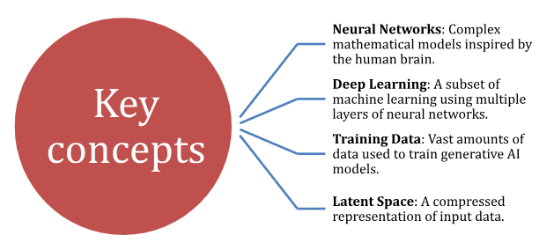
Definition and Core Concepts
Generative AI refers to AI algorithms capable of creating new, original content based on patterns learned from existing data.
Unlike traditional AI systems that primarily analyze and interpret data, generative AI can produce novel outputs such as text, images, audio, and complex financial models.

Slide 4
Importance in Modern Technology and Finance
Generative AI is transforming various aspects of the financial sector:
Risk Assessment and Management: Creating sophisticated models to simulate market conditions and predict potential risks.
Fraud Detection: Generating patterns of normal and fraudulent behavior for more accurate identification.
Personalized Financial Services: Enabling highly tailored financial products and advice.
Algorithmic Trading: Generating trading strategies based on historical data and current market conditions.
Regulatory Compliance: Assisting in creating and analyzing regulatory reports.
Financial Forecasting: Providing more accurate and nuanced financial forecasts.

Slide 5
Types of Generative Models
1. Generative Adversarial Networks (GANs): GANs consist of two neural networks competing against each other:
a. Generator: Creates synthetic data samples.
b. Discriminator: Evaluate the authenticity of the samples.
Strengths: High-quality output, unsupervised learning, and versatility.
Limitations: Training instability, lack of interpretability, and computational intensity.
Applications in finance: Market simulation, fraud detection, risk management, asset pricing, and data augmentation.

Slide 6
Types of Generative Models
2. Variational Autoencoders (VAEs): VAEs combine principles from neural networks and probabilistic graphical models:
Encoder: Compresses input data into a lower-dimensional latent space.
Decoder: Reconstructs the original data from the latent representation.
Strengths: Probabilistic framework, continuous latent space, and efficient inference.
Limitations: Blurry outputs and difficulty handling discrete data.
Applications in finance: Anomaly detection, portfolio optimization, time series forecasting, customer segmentation, and synthetic data generation.

Slide 7
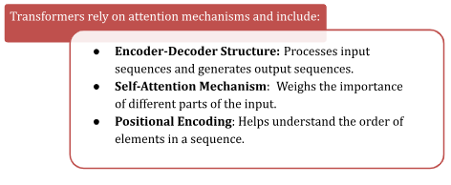
Types of Generative Models
3. Transformers
Strengths: Parallelization, capturing long-range dependencies, and scalability.
Limitations: Computational complexity and data hunger.
Applications in finance: Market prediction, sentiment analysis, risk assessment, algorithmic trading, and financial document analysis.

Slide 8
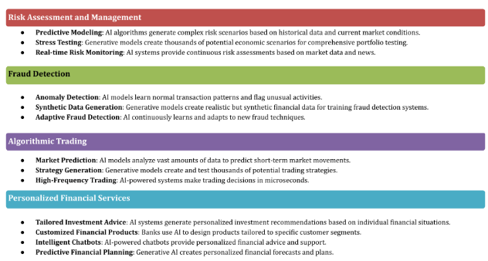
Generative AI in Finance: A Deeper Look

Slide 9
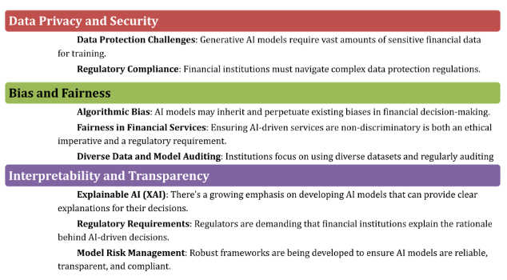
Ethical Considerations and Limitations

Slide 10
Future Trends and Potential Developments
1. Emerging Architectures:
Hybrid Models: Combining strengths of different AI models for enhanced capabilities.
Federated Learning: Training models across decentralized devices without exchanging data.
Neuro-symbolic AI: Combining neural networks with symbolic AI for more interpretable systems.
2. Integration with Other AI Technologies:
AI and Blockchain: Potential to revolutionize smart contracts and decentralized finance.
AI and Internet of Things (IoT): Processing vast amounts of real-time data from IoT devices.
AI and Quantum Computing: Potential for unprecedented computational power in financial modeling.

Slide 11
Future Trends and Potential Developments
3. Anticipated Impact on the Finance Industry:
Hyper-Personalization: Tailored financial products and advice based on individual circumstances.
Real-Time Decision Making: Improved speed and accuracy in trading and risk management.
Democratization of Financial Expertise: Making sophisticated financial advice more accessible.
Regulatory Technology (RegTech): AI-powered compliance reporting and adaptive regulations.
Ethical AI in Finance: Developing frameworks for fairness, transparency, and accountability.
Notes:
Conclusion
Generative AI is poised to revolutionize the financial industry through enhanced decision-making, personalization at scale, improved risk management, democratization of financial expertise, better regulatory compliance and fraud prevention, increased market efficiency, and innovation in financial products.
As the integration of generative AI into finance continues, professionals who embrace this technology and develop the skills to leverage it effectively will be well-positioned to lead in this new era of AI-driven finance. The potential for innovation and improvement is vast, and understanding the fundamentals, applications, and ethical considerations of AI in finance is crucial for navigating this exciting transformation.

Slide 12
Case Studies of Generative AI in Financial Services
The financial services industry is undergoing a profound transformation driven by the rapid advancement and adoption of generative AI technologies.
This revolutionary shift reshapes traditional financial processes, creates new opportunities, and challenges established norms across the sector.

Slide 13
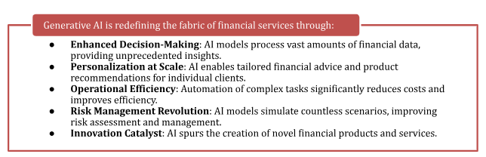
Case Studies of Generative AI in Financial Services
The Transformative Impact of Generative AI in Finance

Slide 14
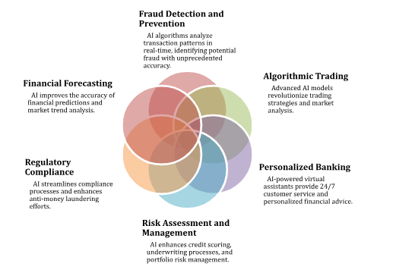
Case Studies
Key Areas Where AI is Revolutionizing Financial Services

Slide 15
Case Studies
Fraud Detection and Prevention
1. JPMorgan Chase's AI-driven Fraud Detection System
JPMorgan Chase has implemented an innovative AI-driven fraud detection system with the following key components:
Behavior-Centric Strategy: Analyzes the network of interactions between users and accounts to identify abnormal patterns.
Machine Learning Algorithms: Scrutinizes customer data to identify potential risks.
Graph-Based Representations: Visualizes complex networks of financial activities to identify sophisticated fraud schemes.
Continuous Learning: Adapts to new fraud tactics as they emerge.
Integration of Cross-Industry Data: Incorporates data from various sources to anticipate fraud trends.
Large Language Models: Analyzes unstructured data for signs of compromise.
Results and Impact:
95% decrease in false positives in anti-money laundering program
Enhanced real-time monitoring of trades
Improved accuracy in detecting sophisticated fraud schemes
Proactive fraud prevention
Increased operational efficiency
Enhanced customer trust.

Slide 16
Case Studies
2. Mastercard's AI-powered Fraud Prevention
Mastercard's Consumer Fraud Risk system leverages advanced machine learning algorithms to analyze transactions in real time:
Large-Scale Data Processing: Analyzes patterns across Mastercard's global network.
AI-Driven Insights: Overlays specific analysis factors for comprehensive fraud detection.
Predictive Capabilities: Predicts potential scams before funds leave a victim's account.
Cross-Bank Collaboration: Partners with multiple banks to enhance effectiveness through data sharing.

Slide 17
Case Studies
Mastercard's AI-powered Fraud Prevention
Key Achievements:
Detects three times the amount of fraudulent transactions compared to previous methods
A tenfold reduction in false positives
Potential savings of £100 million annually across the U.K. banking sector
Global scalability and continuous learning capabilities

Slide 18
Case Studie -Algorithmic Trading and Market Analysis
1. Goldman Sachs' Machine Learning Algorithms
Goldman Sachs Electronic Trading (GSET) has developed sophisticated machine-learning algorithms for trading and market analysis:
Adaptive Algorithms: Adjust trading strategies in real-time based on market conditions.
Smart Order Routing: Routes orders based on various factors for optimal execution.
Customized Strategies: Leverages historical data to select appropriate strategies.
High-Frequency Trading: Executes trades at high speeds to capitalize on price discrepancies.
Market Analysis Capabilities:
Predictive analytics for market trends and asset prices
Sentiment analysis using NLP algorithms
Risk assessment across various asset classes
Market microstructure analysis for optimized trade execution
Anomaly detection for identifying trading opportunities or risks

Slide 19
Case Studie -Algorithmic Trading and Market Analysis
2. Morgan Stanley's AI-Enhanced Wealth Management
Morgan Stanley has leveraged AI to revolutionize wealth management:
Next Best Action System: Provides tailored investment recommendations based on client data and market trends.
Integration with OpenAI: Leverages GPT-4 technology to enhance personalization capabilities.
Enhanced Client Communication: Delivers timely, customized messages guided by financial advisors.
Risk Assessment and Portfolio Optimization:
Portfolio Risk Platform combining industry expertise with BlackRock's Aladdin Risk Engine
Real-time risk analysis for dynamic portfolio management
Scenario planning to simulate various market conditions
Holistic view of client investments for effective portfolio optimization

Slide 20
Case Studies - Personalized Banking Services
1. Bank of America's AI Assistant, Erica
Erica, launched in 2018, combines predictive analytics and natural language processing to provide a wide range of banking services:
Features and Capabilities:
Transaction management and search
Balance information and bill management
Credit score updates
Money transfer and bill payments
Subscription and bill monitoring
Spending analysis
Card management
Intelligent routing to specialists
Accessibility features

Slide 21
Case Studies - Personalized Banking Services
Customer Engagement Metrics:
Over 1.5 billion customer interactions since launch
56 million requests per month
35% year-over-year growth in 2023
Over 37 million users
3 million hours of chat time in 2022
60% of interactions involve seeking advice and insights

Slide 22
Case Studies - Personalized Banking Services
2. Wells Fargo's Predictive Banking
Wells Fargo's AI-powered predictive banking tool offers personalized financial guidance:
AI-Driven Financial Advice:
Spending analysis over a six-month period
Predictive recommendations for saving money
Bill payment forecasting
Real-time insights through mobile app
Goal-oriented advice
Risk mitigation alerts

Slide 23
Case Studies - Personalized Banking Services
Personalized Product Recommendations:
Tailored offerings based on customer data
Contextual recommendations
Customer Engagement Engine for banker insights
Proactive suggestions based on financial profiles
Cross-selling optimization
Lifecycle-based recommendations

Slide 24
Case Studies - Personalized Banking Services
Risk Assessment and Management
1. BlackRock's Aladdin Platform
Aladdin (Asset, Liability, Debt, and Derivative Investment Network) is a comprehensive investment management and risk analytics platform:
AI Integration for Risk Analysis:
Advanced data processing of market data and economic indicators
Predictive analytics for market movements
Sophisticated stress testing and scenario analysis
Natural language processing for sentiment analysis
Continuous learning and adaptation

Slide 25
Case Studies - Personalized Banking Services
Portfolio Risk Management:
Holistic risk view across multiple asset classes
Real-time risk monitoring
Factor-based risk analysis
Custom risk models
ESG risk integration
Liquidity risk management

Slide 26
Case Studies - Personalized Banking Services
2. AXA's AI-Powered Underwriting Process
AXA has implemented advanced AI systems to enhance its risk assessment processes:
Automated Risk Assessment:
AI-driven document analysis for site surveys and risk reports
Real-time monitoring of assets and building health
Predictive modeling for large-scale accidents
Automated submission processing for commercial insurance

Slide 27
Case Studies - Personalized Banking Services
Improved Accuracy and Efficiency:
Enhanced prediction accuracy (from 40% to 78% for large traffic accidents)
Rapid response to emergencies (e.g., RAAC crisis building identification)
Reduced manual workload for underwriters
Improved data quality for risk assessments
Scalable risk assessment across large portfolios
Personalized insurance pricing based on individual risk profiles

Slide 28
Case Studies -Regulatory Compliance and Reporting
1. HSBC's AI Compliance Tools
HSBC has leveraged AI to enhance its anti-money laundering (AML) capabilities and automate regulatory reporting:
Anti-Money Laundering Capabilities:
Dynamic Risk Assessment system developed with Google Cloud
Improved detection rates (2-4 times more suspicious activity identified)
60% reduction in false positive alerts
Network analysis for identifying criminal networks
Faster processing of billions of transactions
Continuous learning to adapt to new financial crime tactics

Slide 29
Case Studies -Regulatory Compliance and Reporting
Automated Regulatory Reporting:
Efficient data processing for regulatory reports
Real-time monitoring of transactions
Improved accuracy in reporting
Adaptive compliance for evolving regulations
Enhanced auditability and transparency

Slide 30
Case Studies -Regulatory Compliance and Reporting
2. Citigroup's AI-Enhanced Compliance Monitoring
Citigroup has implemented advanced AI systems for transaction surveillance and regulatory change management:
Transaction Surveillance:
Advanced Risk Analytics Scoring Engine processing 9 million transactions annually
Real-time analysis of transactions
Natural language processing for understanding networks and unstructured data
Anomaly detection for combating money laundering and cyber-crime
Process automation for focusing on high-risk activities

Slide 31
Case Studies -Regulatory Compliance and Reporting
Regulatory Change Management:
Intelligent Document Processing for tax services
Adaptive compliance framework
Automated regulatory reporting
Continuous monitoring of regulatory changes
Integration with risk management processes

Slide 32
Case Studies - Future Trends and Implications
1. Emerging AI Technologies in Finance:
Advanced Natural Language Processing for complex document analysis
Quantum AI for unprecedented computational power in financial modeling
Explainable AI (XAI) for transparent decision-making
Federated Learning for collaborative AI model training while maintaining data privacy
2. Ethical Considerations and Challenges:
Addressing algorithmic bias in lending and investment decisions
Ensuring data privacy and security
Establishing transparency and accountability in AI-driven decisions
Managing job displacement and reskilling the workforce

Slide 33
Case Studies - Future Trends and Implications
3. The Evolving Role of Financial Professionals:
Shift from data processors to strategic advisors
Increased focus on AI literacy and management
Emphasis on interdisciplinary collaboration
Enhanced customer relationship management
Greater involvement in innovation and product development

Slide 34
Conclusion
The case studies explored demonstrate the transformative potential of generative AI in finance:
Enhanced decision-making through data-driven insights
Personalization of financial services at scale
Revolutionary risk management capabilities
Significant improvements in operational efficiency
Creation of innovative financial products and services
Democratization of financial expertise
Enhanced regulatory compliance and fraud prevention
Increased market efficiency
Notes:
As generative AI continues to reshape the finance industry, it brings both opportunities and challenges. Financial professionals who embrace this technology, understand its capabilities and limitations, and navigate its ethical implications will be well-positioned to lead in this new era of AI-driven finance.
The integration of generative AI into finance is an ongoing journey with vast potential for innovation and improvement. By understanding the fundamentals, applications, and implications of AI in finance, professionals are now equipped to be at the forefront of this exciting transformation, playing a pivotal role in shaping the future of finance.

Slide 35
Fundamentals of Generative AI in Finance
What to Expect:
• A 10-15 minute strategic conversation that helps you connect lesson concepts to your financial work environment • Questions designed to help you identify specific AI opportunities relevant to your role and industry sector • Personalized guidance on prioritizing AI initiatives based on your organization's readiness and resources • Support in building confidence for your AI implementation journey in finance
Notes:
You've just completed an important lesson about generative AI applications in finance. Now it's time to bridge what you've learned with your real-world financial operations and start planning how to apply these powerful AI concepts effectively.

Slide 36
Fundamentals of Generative AI in Finance
How to Engage Effectively:
• Think specifically about your current financial challenges and how AI might address them • Share your industry context—different finance sectors have unique AI applications and considerations • Be honest about constraints—budget, technical expertise, regulatory requirements, organizational readiness • Ask about examples if you need help visualizing how concepts apply to your specific financial situation • Voice concerns about implementation challenges, compliance issues, or potential risks • Consider your stakeholders—who would need to be involved in AI initiatives at your organization?

Slide 37
Fundamentals of Generative AI in Finance
Remember:
• AI implementation in finance is a gradual process—start small and build momentum • Every financial organization has unique AI opportunities based on their specific context and challenges • The AI coach will help you identify realistic next steps based on your situation • Always verify technical details and consider consulting with compliance and risk management before major implementations • Your financial expertise combined with AI knowledge creates powerful opportunities for innovation
Notes:
Ready to explore how AI can transform your financial operations? Let's begin strategizing!

Slide 38
Open Dialouge - Activity
In this Dialogue, we'll explore how to synthesize lesson concepts with your specific financial context, identify relevant AI opportunities, and develop a prioritized action plan for exploring AI implementation in your finance organization.
Here's what we'll cover:
Concept-to-Context Translation: Connecting AI concepts to your financial challenges.
Opportunity Assessment: Identifying and prioritizing specific AI opportunities in your financial operations.
Implementation Planning: Addressing practical considerations for integrating AI.
Action Commitment and Support: Committing to concrete next steps and addressing concerns.

Slide 39
Quiz
Question 1
Which of the following best describes generative AI in the context of finance?
An AI that can create new content, predictions, or solutions based on patterns in financial data
A tool exclusively used for stock trading
A system that only analyzes historical financial data
A database of pre-programmed financial responses
Answer A

Slide 40
Quiz
Question 2
Which of the following are applications of generative AI in finance? (Select all that apply)
Personalized investment advice
Risk assessment
Customer service automation
Fraud detection
Physical currency production
Answer A B C D

Slide 41
Quiz
Question 3
What is a potential limitation of generative AI in finance?
It can process large amounts of data quickly
It may perpetuate biases present in training data
It can identify complex patterns in financial markets
It can operate 24/7 without breaks
Answer B

Slide 42
Quiz
Question 4
Which type of generative AI model is commonly used for natural language processing tasks in finance?
Generative Adversarial Networks (GANs)
Simple Recurrent Neural Networks (RNNs)
Transformers
Convolutional Neural Networks (CNNs)
Answer C

Slide 43
Quiz
Question 5
What is the key benefit of using generative AI in financial forecasting?
It only uses publicly available data
It guarantees 100% accurate predictions
It can consider a wider range of variables and scenarios than traditional methods
It eliminates the need for human oversight entirely
Answer C

